Slide 2
Oral Statements
Oral statements or discussions during this Non-Mandatory Pre-bid meeting today will not be binding, nor will it change or affect the terms or conditions within the Plans and Specifications of this Project. Changes, if any, will be addressed in writing only via an Addendum.

Slide 3
Agenda
General Information
SMWB Requirements
Contract Solicitation Site
Vendor Registration
Contract Requirements
Bid Packet Preparation
IFB Schedule
Bid Opening Procedures
Reminders
Project Overview
Project Location
Special Conditions
Questions

Slide 4
General Information
This is a Non-Mandatory Pre-bid meeting
Attendees should sign-in
This presentation and the attendance sheet will be posted to the SAWS website
Key project information:
  Construction duration is 365 calendar days
  Estimated budget is $ 2,400,000.00
Construction services being procured through low bid

Slide 5
Aspirational SMWB Goal
Industry | Aspirational SMWB Goal
Construction | 21%
The aspirational SMWB goal is 21% of your total bid price.
Notes:
Contracting

Slide 6
Minimum Qualifications for SMWB recognition:
South Central Texas Regional Certification Agency
Must be SBE-Certified (including MBEs and WBEs)
Texas Historically Underutilized Business “HUB” Program
Local Office or Local Equipment Yard
      Bexar, Comal, Guadalupe, Hays, Kendall, Travis, and Williamson counties
Notes:
SMWB

Slide 7
Good Faith Effort Plan (GFEP) FAQs
Q: Is the 21% SMWB goal mandatory?
A: No, but we ask prime contractors to do their best with good faith outreach efforts. If the goal is not met, proof of outreach efforts is required with the submittal.
Q: What if I am having trouble finding SMWB subcontractors?
A: Outreach lists from the South Central Texas Regional Certification Agency are now Excel-exportable at www.sctrca.org. If you are having trouble with the downloads, please email the SMWB Program Manager.
Q: What if my business is SMWB-certified? Do I need to find SMWB subs?
A: If your firm is SMWB-certified, you will most likely meet the goal. However, the GFEP is a required document, and a good faith outreach effort is still necessary.
Q: Do I need to include all my subcontractors in the GFEP or just those that qualify towards the
SMWB goal?
A: All subcontractors need to be included in the GFEP, even those that may not count towards the SMWB goal.
Q: What if I have questions about the GFEP?
A: Please contact the SMWB Program Interim Manager at 210-233-3070, or at Susan.Rodriquez@saws.org . GFEP questions can be asked at any time before the submittal is due.
Notes:
SMWB

Slide 8
1. Subcontractor & Supplier Payment Tracking
2. Subcontractor and Supplier Additions or Substitutions
3. Must be Current and Accurate before Retainage is released (different than LCP tracker) https://saws.smwbe.com
Post Award: Subcontractor Payment & Utilization Reporting (S.P.U.R.) System

Slide 9
Questions related to SMWB participation, completion of the Good Faith Effort Plan (GFEP), or SMWB scoring may be directed to Susan Rodriquez, Interim SMWB Manager until the IFB is due.
Email: Susan.Rodriquez@saws.org

Slide 10
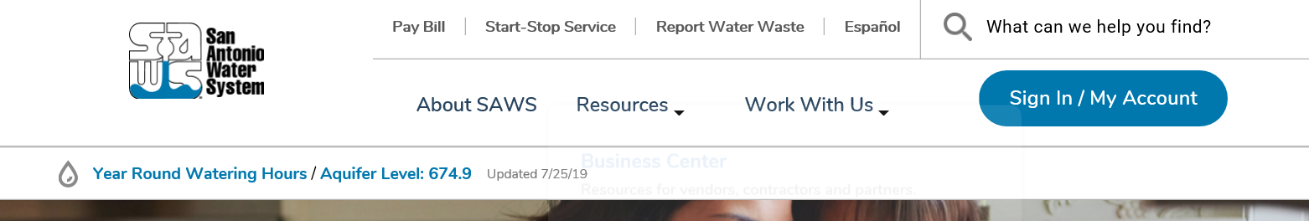
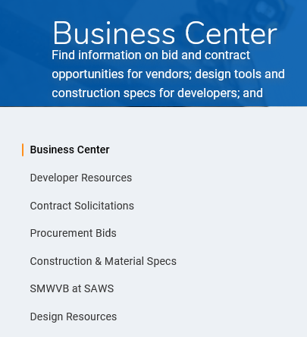
Contract Solicitations Website
To locate the Contract Solicitations website, choose Resources
Click on Business Center
At the drop-down menu choose Contract Solicitations

Slide 11
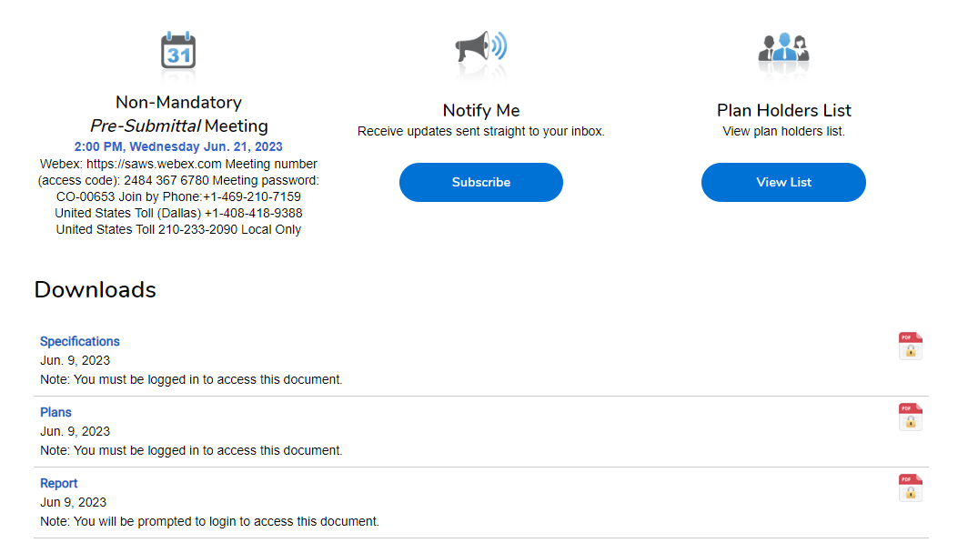
Contract Solicitations Website
Choose the specific project
The following buttons are now located under the advertisement:
  Notify Me
  Plan Holder’s List
  Downloads
    Plans
    Specs
    Addendums

Slide 12
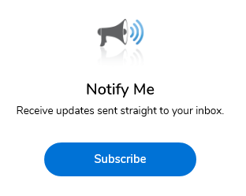
Vendor Registration & Notification (VRN)
Please register through SAWS Vendor Registration Program on the SAWS website at www.saws.org to ensure access to the latest information.
To receive updates on specific projects, registered vendors must ‘Subscribe’ to the project by selecting the project and clicking ‘Subscribe’ under the Notify Me box.
https://apps.saws.org/Business_Center/Contractsol/

Slide 13
Contract Requirements
Prevailing Wage Rate and Labor Standards – Section 2.10 of the General Conditions
Certified payroll to be submitted on weekly basis including weeks in which work is not performed by noting as such (Be familiar with SAWS Holidays)
Wage decisions are included within the specifications
Contractors (and their subcontractors) shall utilize LCP Tracker
  Site visits by SAWS staff are random and unannounced
  Interviews will be conducted and will be private & confidential
  Payroll records are subject to review
  All apprenticeship programs will need to be approved by Department of Labor prior to starting
  The Prime Contractor is responsible for sub-contractor payroll
  Late payrolls may delay contractor payments, as well as release of retainage

Slide 14
Contract Requirements
Insurance requirements for this project are found in Section 5.7 of the GCs
  Pollution Liability
  Installation Floater
SAWS will ask for insurance prior to Board award to expedite execution of the contract
  Any deficiencies must be corrected prior to Board award
Contractor's insurance must be compliant on all SAWS projects, including this one, prior to executing the contract
Contractor must maintain insurance coverage during term of construction of this Project

Slide 15
Contract Requirements
The Contractor shall perform the Work with its own organization on at least 40% of the total original contract price to be confirmed by inserting the percentage performed by the Bidder on page 1 of the Good Faith Effort Plan.
Liquidated Damages are $125.00 per day.

Slide 16
Bid Packet Preparation
Utilize the Bid Packet Checklist within the specifications which identifies:
  Items due with the bid
    List of Bid Items
      Double check all mathematical calculations and verify all extensions for each of the line items
    Signed Bid Proposal Signature Page
      Acknowledgement of ALL addendums and Executive Order
    Bid Packet Checklist (all boxes checked)
    Signed Proposal Certification
    Bid Bond
    Good Faith Effort Plan
    Waiver of retainage from Surety Company (at Bidder’s option)

Slide 17
Bid Packet Preparation (Cont.)
  Items to be submitted upon request by SAWS from the Apparent Low Bidder within one (1) day of the bid opening, which include:
  Conflict of Interest Questionnaire – Form CIQ
  Proof of Insurability (Letter from Insurer or Sample Certificate of Insurance)
  Company Information Packet
  Statement Regarding Ability to Complete the Project
  W-9
  Statement of Bidder’s Experience
  *And, if bid was submitted electronically without a Bid Bond:
    Cashier’s Check or Certified Check
  Failure to complete the forms properly may result in the bid being found non-responsive

Slide 18
IFB Schedule
Board Award
On December 5, 2023
Questions Due
By 4:00 PM
on September 27 , 2023
FTP request Due
By 1:00 PM
on September 29, 2023
Answers Due
By 4:00 PM
on September 28, 2023
Bids Due
By 1:00 PM
on October 2, 2023

Slide 19
Bid Opening Procedures
SAWS has implemented the following procedures for the submission of bids.
  Bids will be received either Electronically or through Sealed bids.
Electronic bids will be received via the secure SAWS FTP site.
Sealed bids will be received by Contract Administration, 2800 U.S. Hwy 281 North, Tower II, Customer Center Building, via a black drop box located on the left wall when walking through the first set of double glass doors of the main Tower II entry on the north side of the building.
If bids will be delivered in person, Bidders should allow sufficient travel time.
Late bids will not be accepted and will be returned and not opened.

Slide 20
Reminders
All questions should be sent in writing via email by the deadline to Theadora.Gonzalez@saws.org
Please identify the project by 2024 Annual Sanitary Sewer Point Repair, MH Adjustment, Laterals Construction, Package I Solicitation No. CO-00690-TG
Please be advised that Bidders are prohibited from communicating with any other SAWS staff, the Consultant, or City of San Antonio officials regarding this IFB up until the contract is awarded as outlined in the Instructions to Bidders.

Slide 21
Project Overview
The San Antonio Water System is soliciting proposals for the purpose of retaining a Contractor to furnish all labor, materials, equipment, and supervision to adjust and/or rehabilitate or replace or install new wastewater collection system manholes, including but not limited to concrete, asphalt and other surface restoration, and associated work throughout the SAWS service area on an annual work order contract basis.
SAWS does not guarantee that the total contract dollar amount of work will be assigned to the Contractor. The contract amount is based on estimated historical quantities for past annual contracts.
Bid Proposal consists of a total one hundred and one (101) Line Items.

Slide 22
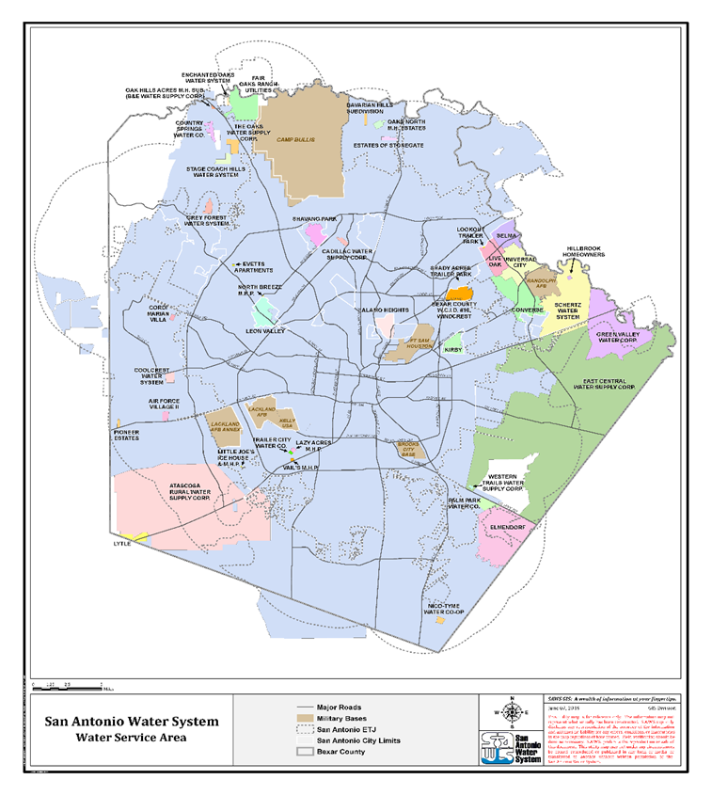
Project Location Map
Work will be located related to SAWS infrastructure throughout the SAWS’ Service Area.

Slide 23
Project Overview
Statement of Bidder’s Experience
  Verify point of contact is accessible and phone number is valid.
    Email addresses are appreciated.
  3 different projects from work order type contracts
  Reference projects completed in the last 5 years.
  Each project requires a valid reference, failure to provide an active and reachable contact could result in being considered non-responsive to the bid.
Notes:
Prep ROW – coordination with CoSA arborist required prior to starting construction

Slide 24
Project Overview
Supplemental Conditions (SS-1 through SS-5)
Article III - Record Drawings (red line drawings required to be submitted with invoicing for payment for each WO).
Article IV - Contractor required to perform minimum 40% of the contract work, based on total contract price, and defined utilizing only:
  Workers employed and paid directly by the Contractor or a wholly owned subsidiary of the contractor.
  Equipment owned by the contractor or subsidiary.
  Rented or leased equipment operated by the Contractor’s, or its wholly owned subsidiaries, employees.
  “Value of the Work self-performed” includes all Materials incorporated where material is performed by Contractor’s own organization.

Slide 25
Project Overview
Supplemental Conditions (continued)
Article V
  Contractor obtains all COSA street cut and ROW permits and complies with all permit requirements.
  Contractor responsible for all costs to obtain and fulfil permit requirements.
  Project signs shall comply with COSA ordinance (inclusive to project), and Barricades will identify Contractor.
  Required Work Site Photographs (3 minimum per location)

Slide 26
Project Overview
Supplemental Conditions (continued)
Article VII – Contract Payments
  Scratch sheet line items and quantities shall be input into SAWS CPMS with all documentation for invoicing and required photos.
  Request for Waiver of Retainage from Surety Company allowed, but if elected, waiver must be included with Bid Packet.
Article VIII – Liquidated Damages
  $125 per calendar day past window of completion per work order.

Slide 27
Project Overview
Special Conditions (SC-1 through SC-7)
SC -1.0 Scope of Work / General
  Adjust and/or rehabilitate or replace or install new sewer manholes, and including but not limited to concrete, asphalt and other surface restoration.
SC -2.2 Work Orders
  All WOs and/or projects to be issued are unspecified at time of bid.
  One WO issued for each manhole.
  Payment on a WO basis.

Slide 28
Project Overview
Special Conditions (continued)
SC -2.3 Bypass Pumping
  When bypass operations are necessary, Contractor responsible to provide Bypass pumping plan and perform execution. Both are incidental to the work, with no additional compensation.
SC – 2.4 Performance Time
  Provide work force capacity to accomplish five (5) WO’s per Day.
  Commence work within 72-hours of written notice, when traffic control and/or bypass pumping plan Not required.
  Commence work within 48-hours of verbal notice for emergency.
  Commence work within five (5) calendar days of written notice, when traffic control and/or bypass pumping plan IS required.
  Complete WO, including site restoration & cleanup, within fourteen (14) calendar days from commencement of work.

Slide 29
Project Overview
Special Provisions to the Technical Specifications (SPTS-1 through 15)
See SAWS Standard Specifications (latest edition) on SAWS website.
Item 100 – Mobilization
  Mobilization is a separate bid item in the Bid Proposal and will be paid on a “per each work order” basis.
Item 550 – Trench Excavation Safety Protection
  Incidental to all work, with no additional compensation.
Item 852 – Sanitary Sewer Manholes
  Note that manhole covers and rings are composite, not CI or DI. The SAWS AML currently has one approved supplier.

Slide 30
Questions
Must be submitted in writing by September 27 by 4:00 P.M. via e-mail to:
Thea Gonzalez
Contract Administration Department
San Antonio Water System
Theadora.Gonzalez@saws.org

